Slide 1
Introduction to NBA
by Dr. Anil Kumar Nassa, Member Secretary, NBA

Slide 2
ACCREDITATION
Accreditation is a process of quality assurance and improvement, whereby a program in an approved Institution is critically appraised to verify that the program continues to meet and/or exceed the Norms and Standards prescribed by regulator from time to time.
It is a kind of recognition which indicates that a program fulfills desired standards.

Slide 3
WHY ACCREDITATION
The purpose of the accreditation by NBA is to promote and recognize excellence in technical education in colleges and universities - at both the undergraduate and post graduate levels. Institutions, students, employers, and the public at large all benefit from the external verification of quality provided through the NBA accreditation process. They also benefit from the process of continuous quality improvement that is encouraged by the NBA's developmental approach to promote excellence in technical education. Through accreditation, the following main purposes are served:
Support and advice to technical institutions in the maintenance and enhancement of their quality of provision;

Slide 4
WHY ACCREDITATION
Confidence and assurance on quality to various stakeholders including students;
Assurance of the good standing of an Institution to Government Departments, Industry and other interested bodies;
Enabling an Institution to state publicly that it has voluntarily accepted independent inspection and has satisfied all the requirements for satisfactory operation and maintenance of quality in education.

Slide 5
BENEFITS AND SIGNIFICANCE OF ACCREDITATION
The purpose and impact of accreditation goes far beyond quality assurance of an Institution and its programs. Major impacts of accreditation system are summarized below:
Encourages quality improvement initiatives by Institutions;
Improves student enrollment both in terms of quality and quantity;

Slide 6
BENEFITS AND SIGNIFICANCE OF ACCREDITATION
Helps the Institution in securing necessary funds;
Enhances employability of graduates;
Facilitates transnational recognition of degrees and mobility of graduates and professionals;
Motivates faculty to participate actively in academic and related Institutional / departmental activities;
Helps create sound and challenging academic environment in the Institution, and Contributes to social and economic development of the country by producing high quality technical manpower.

Slide 7
WHO GETS ACCREDIT
Individuals, courses, and institutions are not accredited. NBA only accredits programs in Engineering, Computer Application, Pharmacy, Management, Hotel Management and Catering Technology.

Slide 8
NATIONAL BOARD OF ACCREDITATION
NBA is committed to provide:
Credible System of Accreditation
Transparent & Accountable System
3

Slide 9
Credible System of Accreditation
Strength and credibility of accreditation process largely lies in the integrity, honesty, expertise and professionalism of Evaluators.
Evaluators – face of NBA.
Transparency-
Report discussed in the meetings of EAC in presence of all team chair
Recommendations of EAC are considered in Sub-committee of AAC
Copy of the report is sent to the Institution
Change in decision communicated to the institution with reasons
360 degree feedback
4

Slide 10
WASHINGTON ACCORD
The membership of Washington Accord is an international recognition of the quality of undergraduate engineering education offered by the member country and is an avenue to bring it into the world class category. It encourages and facilitates the mobility of engineering graduates and professionals at international level.
India became Permanent Signatory status in June, 2014 and again in 2020 got the Permanent Signatory status of Washington Accord for a further period of six years. In the Washington Accord, India is represented by National Board of Accreditation(NBA).

Slide 11
WHAT IS NOT THE PURPOSE OF ACCREDITATION
Not to find faults with the institution but to assess the status- ante of the performance.
Not to denigrate the working style of the institution and its programs but to provide a feed back on their strengths and weaknesses.
Not to demarcate the boundaries of quality but to offer a sensitizing process for continuous improvement in quality provisions.
Not to select only institutions of national excellence but to provide benchmarks of excellence and identification of good practices.

Slide 12
General Policy on Accreditation
The following general policies are the guiding principles for the accreditation of programs:
Programs, and not Educational Institutions, are considered for accreditation.
Programs from which at least two batches of students have graduated are considered for accreditation.

Slide 13
What is Outcome based Education?
What the students need to learn?
What the students should demonstrate to the professional world?
Accordingly designing both curricula and delivery mechanisms(teaching strategies) to build the required skills and competence.

Slide 14
Program Outcomes (POs)-Present
Engineering knowledge: Apply the knowledge of mathematics, science, engineering fundamentals, and an engineering specialization to the solution of complex engineering problems.
Problem analysis: Identify, formulate, review research literature, and analyze complex engineering problems reaching substantiated conclusions using first principles of mathematics, natural sciences, and engineering sciences.
Design/development of solutions: Design solutions for complex engineering problems and design system components or processes that meet the specified needs with appropriate consideration for the public health, safety, and the cultural, societal, and environmental considerations
Conduct investigations of complex problems: Use research-based knowledge and research methods including design of experiments, analysis and interpretation of data, and synthesis of the information to provide valid conclusions.
Modern tool usage: Create, select, and apply appropriate techniques, resources, and modern engineering and IT tools including prediction and modeling to complex engineering activities with an understanding of the limitations.
The engineer and society: Apply reasoning informed by the contextual knowledge to assess societal, health, safety, legal and cultural issues and the consequent responsibilities relevant to the professional engineering practice.

Slide 15
Program Outcomes (POs)-Present
Environment and sustainability: Understand the impact of the professional engineering solutions in societal and environmental contexts, and demonstrate the knowledge of, and need for sustainable development.
Ethics: Apply ethical principles and commit to professional ethics and responsibilities and norms of the engineering practice.
Individual and team work: Function effectively as an individual, and as a member or leader in diverse teams, and in multidisciplinary settings.
Communication: Communicate effectively on complex engineering activities with the engineering community and with society at large, such as, being able to comprehend and write effective reports and design documentation, make effective presentations, and give and receive clear instructions.
Project management and finance: Demonstrate knowledge and understanding of the engineering and management principles and apply these to one‟s own work, as a member and leader in a team, to manage projects and in multidisciplinary environments.
Life-long learning: Recognize the need for, and have the preparation and ability to engage in independent and life-long learning in the broadest context of technological change.

Slide 16
NBA Outcome Based Accreditation
Two Tier System
Introduction of Two-Tier System based on Types of Institutions.
The Tier-I documents applicable to the engineering/technology programs offered by academically autonomous institutions and by university departments and constituent colleges of the universities.
Tier-II documents: for non-autonomous institutions, i.e., those colleges and technical institutions which are affiliated to a university.
For both: Same set of criteria have been prescribed for accreditation.

Slide 17
During the two and a half day visit, team has discussions with:
The Head of the institute/Dean/Heads of Department /Program and course coordinators
A member of the management (to discuss how the program fits into the overall strategic direction and focus of the institution and management support for continued funding and development of the program)
Faculty members
Alumni
Students
Employers
11

Slide 18
Marks Comparison of SAR of UG Engineering Tier-I & Tier II (First Cycle)
S.No. | Criteria | UG Engineering
 |  | Tier-I | Tier-II
1. | Vision, Mission and Program Educational Objectives | 50 | 60
2. | Program Curriculum and Teaching – Learning Processes | 100 | 120
3. | Course Outcomes and Program Outcomes | 175 | 120
4. | Students’ Performance | 100 | 150
5. | Faculty Information and Contributions | 200 | 200
6. | Facilities and Technical Support | 80 | 80
7. | Continuous Improvement | 75 | 50
8. | First Year Academics | 50 | 50
9. | Student Support Systems | 50 | 50
10. | Governance, Institutional Support and Financial Resources | 120 | 120
TOTAL |  | 1000 | 1000

Slide 19
Pre-Qualifiers (TIER-I UG Engineering)
S.N. | Pre Visit Qualifiers (Average of Assessment years) | Current Status | Compliance Status Complied/Not Complied
 | Essential qualifiers
1 | Vision, Mission & PEOs Are the Vision & Mission of the Department stated in the Prospectus / Website? Are the PEOs of the Program listed in the Prospectus / Website?
2 | Whether approval of the competent authority (Approval of AICTE/ UGC/ BoG of Universities/ Deemed Universities etc.) for the programs under consideration has been obtained for all the years including current year
3 | Whether admissions in the undergraduate programs under consideration has been more than or equal to 60% (including lateral entry) average of the CAYm1, CAYm2 and CAYm3. . | % Admission
4 | Whether faculty student ratio in the department under consideration is better than or equal to 1:25 averaged over CAY, CAYm1 and CAYm2 | SFR

Slide 20
6 | Whether at least two Professors or one Professor and one Associate Professor on regular basis with Ph.D. degree is available in the respective Department for CAY and CAYm1.
7 | Whether number of available PhDs in the department is greater than or equal to 20% of the required number of faculty averaged for CAY and CAYm1.
8 | Whether two batches have passed out in the programs under consideration
9 | Whether HODs possess Ph.D. degrees for the programs under consideration

Slide 21
The Student Faculty Ratio considered by NBA:
UG Engineering Programs (Tier I & Tier II):- 25:1 for the Accreditation of 3 years and 20:1 for the Accreditation of 6 years.
PG Engineering Programs: 25:1 for the Accreditation of 3 years and 20:1 for the Accreditation of 6 years.
Diploma Engineering Programs: 30:1 for the Accreditation of 3 years
PG Management Programs: 25:1 for the Accreditation of 3 years and 15:1 for the Accreditation of 6 years.
UG Pharmacy: 20:1 for the Accreditation of 3 years and 15:1 for the Accreditation of 6 years.

Slide 22
Attributes of Program Evaluators
Enthusiastic volunteer
Technically competent
Well-regarded
Effective communication
Listening skill
Interpersonal skill
Team-oriented
Professional approach
Courteous
Time management
Organized

Slide 23
Conflict of Interest
Definition of possible conflict of interest:
have financial or personal interest in the university/institution; or
have or have had a close, active association with the programme or faculty/school in the university/institution. Close or active association are, for example:
Employment, as staff or consultant;
Attendance, as student at the faculty/school;
Receipt of honorary degree from the faculty/school;
Membership of a board of the university or any committee advising on the programme being accredited.

Slide 24
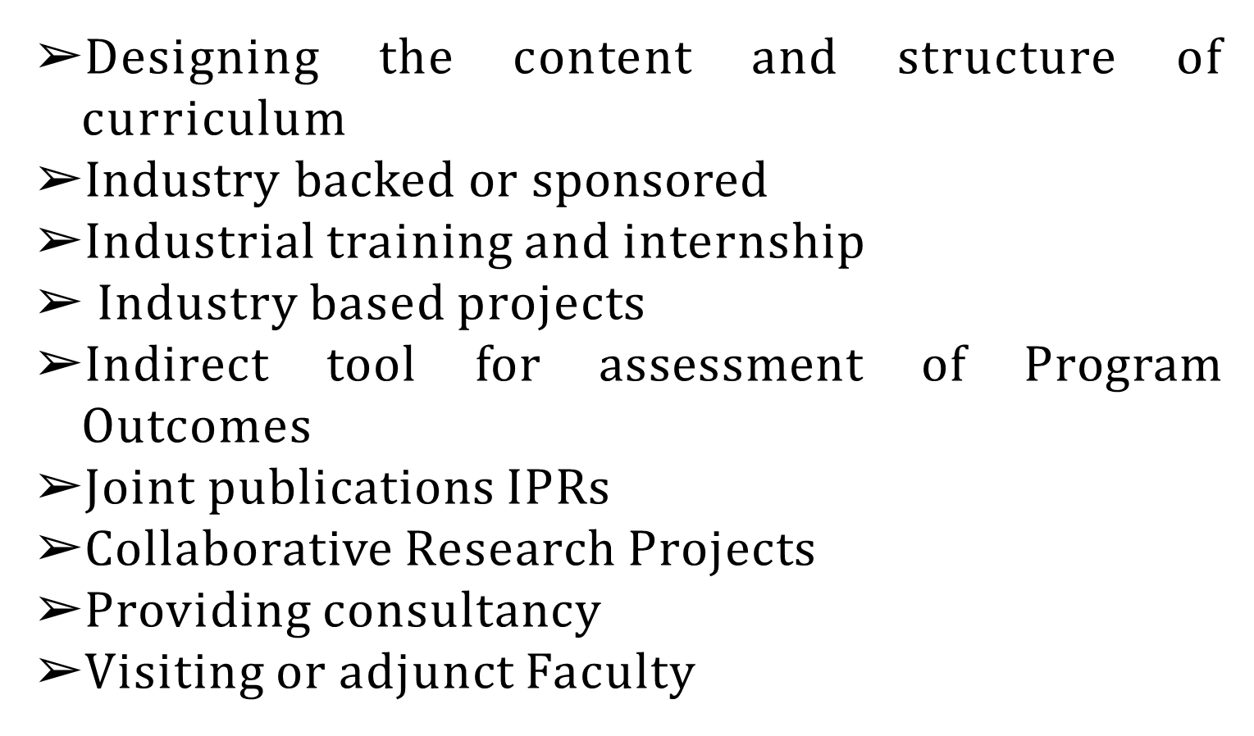
INDUSTRY PARTICIPATION

Slide 25
Major focus during visit
Quality assurance processes, including internal reviews
Entry standards for admission of students
Qualifications, enthusiasm, workload of faculty
Facilities
Industry participation
Title of a programme as shown on graduate’s certificate and transcript

Slide 26
Guidelines
The evenings of the visiting team are deliberately kept free of activities to enable the team to complete the writing of the report.
It is extremely important to note that the visiting team members do not indicate to the institution whether they would accredit or not accredit the programme and that the report is strictly confidential.
After the conclusion of the exit meeting, all contacts of the institution should be through NBA only. If Institution contacts the team members, they should be advised to contact NBA.

Slide 27
Assessment by the Experts and the Chairperson should be holistic and fair.
Finding must be filled in ink in each and every cell in Program Evaluation Worksheet. If there is any crossing, the same must be counter signed by both the experts.
Avoid subjectivity in awarding marks as far as possible.

Slide 28
NBA
makes
travel arrangement for the
team
members including accommodation
and travel to or from the campus where the program is delivered through the authorized travel agencies.
NBA requires every team member to exhibit the highest standard of professionalism, honesty and integrity.

Slide 29
Programs Considered for Accreditation by NBA since 2004-05
Sr. No. | Year | Accredited | Not Accredited | Withdrawn | Total
1 | 2004-05 | 559 | 65 | 11 | 635
2 | 2005-06 | 96 | 99 | 1 | 196
3 | 2006-07 | 464 | 90 | 5 | 559
4 | 2007-08 | 746 | 56 | 19 | 821
5 | 2008-09 | 1055 | 140 | 20 | 1215
6 | 2009-10 | 568 | 88 | 10 | 666
7 | 2010-11 | 73 | 12 | 0 | 85
8 | 2011-12 | 297 | 88 | 12 | 397
9 | 2012-13 | 474 | 126 | 18 | 618
10 | 2013-14 | 550 | 190 | 0 | 740
11 | 2014-15 | 510 | 99 | 2 | 611
12 | 2015-16 | 341 | 52 | 1 | 394
13 | 2016-17 | 739 | 146 | 2 | 887
14 | 2017-18 | 867 | 200 | 9 | 1076
15 | 2018-19 | 1080 | 198 | 6 | 1284
16 | 2019-20 | 1110 | 210 | 2 | 1322
17 | 2020-21 | 738 | 27 | 0 | 765
18 | 2021-22 | 1411 | 50 | 0 | 1461
19 | 2022-23 | 2348 | 212 | 7 | 2567
20 | till July 2023 | 513 | 75 | 0 | 588
Total |  | 14539 | 2223 | 125 | 16887

Slide 30
National Institutional Ranking Framework (NIRF)
The National Institutional Ranking Framework (NIRF) for engineering and management categories was unveiled by Ministry of Human Resource Development on 29th September, 2015. Soon after, the NIRF for ranking of the pharmacy and architecture institutions as well as for colleges & universities were released.
The final framework identified nearly 22 parameters in five broad generic parameters, namely: i) Teaching, Learning and Resources; ii) Research and Professional Practice; iii) Graduation Outcome; iv) Outreach and Inclusivity; and v) Perception.
Several of them are similar to those employed globally such as excellence in teaching, learning and research. However, there are a few which are India-centric, reflecting aspirations of the rising numbers of young people of a vast nation.

Slide 31
S. No. | Parameters | Marks
1. | Teaching, Learning & Resources (TLR) Ranking weight: 0.30 | 100
 | Student Strength including Doctoral Students(SS): 20 marks Faculty-student ratio with emphasis on permanent faculty (FSR): 30 marks Combined metric for Faculty with PhD (or equivalent) and Experience (FQE): 20 marks Financial Resources and their Utilisation (FRU): 30 Marks
2. | Research and Professional Practice (RP) Ranking weight: 0.30 | 100
 | Combined metric for Publications (PU): 35 marks Combined metric for Quality of Publications (QP): 35 marks IPR and Patents: Published and Granted (IPR): 15 marks Footprint of Projects and Professional Practice (FPPP): 15 marks

Slide 32
3. | Graduation Outcomes (GO) Ranking weight: 0.20 | 100
 | Metric for University Examinations(GUE): 60 marks Metric for Number of Ph.D. Students Graduated (GPHD): 40 marks
4. | Outreach and Inclusivity (OI) Ranking weight: 0.10 | 100
 | Percentage of Students from Other States/Countries (Region Diversity RD): 30 Marks Percentage of Women (Women Diversity WD): 30 Marks Economically and Socially Challenged Students (ESCS): 20 marks Facilities for Physically Challenged Students (PCS): 20 marks
5. | Perception (PR) Ranking weight: 0.10 | 100
 | Peer Perception: Academic Peers and Employers (PR): 100 Marks

Slide 33
India Rankings 2016 – 2023
In the year 2016, rankings were announced for the first time for Universities and for the specific disciplines of Engineering, Management and Pharmacy.
In India Rankings 2017, Common Overall Ranking and Ranking of General Degree Colleges was introduced.
In India Rankings 2018, three new categories namely, law, medicine and architecture were introduced bringing the tally to total nine rankings.
In India Rankings 2019, the NIRF continued with all these nine rankings.
In India Rankings 2020, new category Dental were introduced bringing tally to ten rankings .
In India Rankings 2021, new category Research Institutions were introduced bringing tally to eleven rankings .
In India Rankings 2022, the NIRF was released for 11 categories.
In India Rankings 2023, two more category Agriculture and Allied Sectors and Innovation were introduced bringing tally to thirteen rankings.

Slide 34
Thank you

